Slide 1
Group 13: Building Blocks - Progress Report
Alan Loh, 胡子皓, Fabien Lahaille

Slide 2
Overview
Through Homework #3 and #4, we’re wrapping up the skills and know-how needed to complete the project
Still need to secure the building blocks we plan on using
Also need to figure out a way to designate placement

Slide 3
Block Recognition
Able to narrow down the field of recognition for objects
Still need to do testing to ensure consistent behavior under ideal test conditions

Slide 4
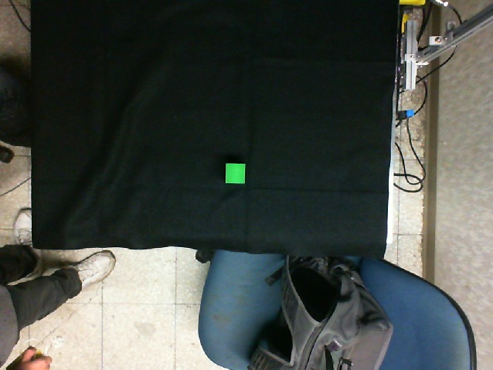
Block Recognition
Original Image

Slide 5
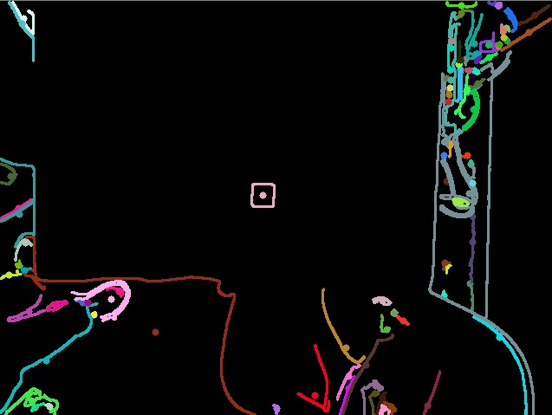
Block Recognition
Raw Contours

Slide 6

Block Recognition
Modified Contours

Slide 7
Robotic Arm and Camera Specs
Understanding coordinates, angles, and other variables used by robotic arm’s software
Camera caliberation

Slide 8
Difficulties
Reserving time to use robotic arm when group members are available
Thus we are only able to use the arm once a week due to scheduling problems
One group member is unfamiliar with C++, and contributes through Matlab

